Slide 1
Ecommerce Operation & Sales Performance Analytics
-By Komal Chahal

Slide 2
COMPANY BACKGROUND
The company is a digital retail entity operating in the E-commerce and Online Retail sector, serving both B2C and B2B clients.
It manages a diverse product portfolio across platforms like Amazon.in, ranging from Ethnic Wear (Sets, Kurtas) to Western apparel.
Currently, the organization is focused on achieving sustainable growth by leveraging data-driven insights to address operational inefficiencies.

Slide 3
Pr0blem statement
The company is facing multiple challenges across financial performance, customer behavior, logistics efficiency, and product management.
High cancellation and return rates, delayed shipments, and inconsistent sales trends are impacting overall business growth and customer satisfaction.
The objective of this analysis is to identify the root causes of these issues and provide data-driven insights to improve operational efficiency and drive sustainable growth.

Slide 4
Project Objective :
The goal of this project is to develop a data-driven Ecommerce Operations & Sales Performance Dashboard to solve key business challenges:
Sales Tracking: Monitor revenue trends, total orders, and average order value (AOV) to evaluate financial health.
Operational Efficiency: Analyze logistics and fulfillment modes to reduce delivery delays and optimize shipping.
Inventory Optimization: Identify top-selling categories and sizes to maintain optimal stock levels and prevent stockouts.
Customer Satisfaction: Track cancellation and return rates to identify problematic products and improve service quality.
Actionable Insights: Use geographical and customer data (B2B vs B2C) to guide marketing and expansion strategies.

Slide 5
Technical tools & DAX Formulas
Tools Used : Power BI Desktop, Power Query Editor
DAX Formulas
Actual Sales = if('sales_dataset'[Status]= "cancelled",0,'sales_dataset'[Amount])
Total Sales = SUM('sales_dataset’)[Actual Sales])
Total Orders = DISTINCTCOUNT('sales_dataset’)[Order ID])
Average Order Value (AOV): DIVIDE([Total Sales], [Total Orders], 0)
Cancellation Rate = DIVIDE(CALCULATE([Total Orders], 'sales_dataset'[Status] = "Cancelled"), [Total Orders], 0)
Month = FORMAT('sales_dataset'[Date],"MMMM")
week day = FORMAT('sales_dataset'[Date],"dddd")

Slide 6
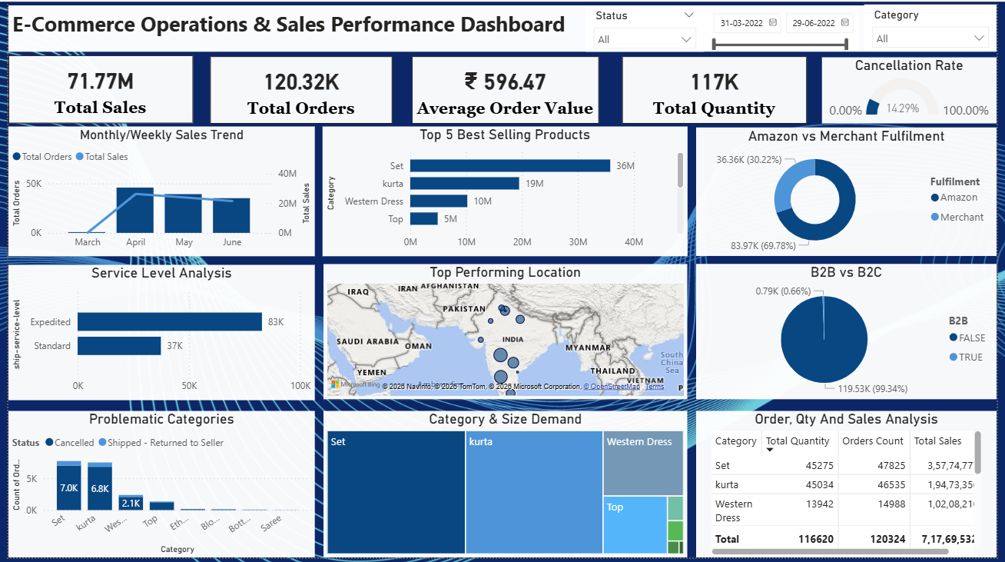
Dashboard Overview

Slide 7
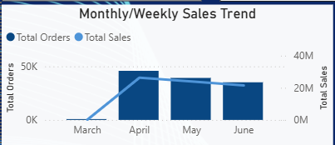
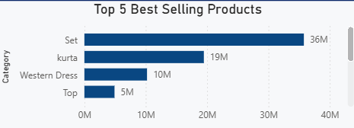
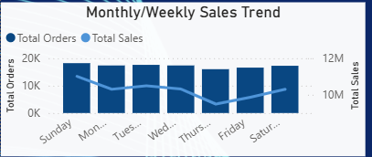
Sales Growth Over Time
Top 5 Best Selling Products
Insight: Displays a sharp revenue peak in April, followed by a stabilization period, indicating a successful seasonal campaign or high-demand period.
Insight: Identifies 'Set' and 'Kurta' as the primary revenue drivers, contributing significantly to the total sales of ₹83.29M.

Slide 8
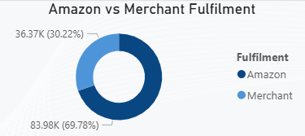
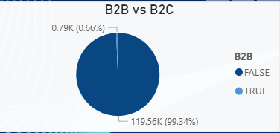
Amazon vs Merchant Fulfillment
B2B vs B2C Sales
Insight: Approximately 70% of orders are fulfilled by Amazon (FBA), suggesting a strong reliance on third-party logistics for delivery efficiency.
Insight: The business is overwhelmingly driven by B2C transactions (99.34%), highlighting a direct-to-consumer market focus.

Slide 9
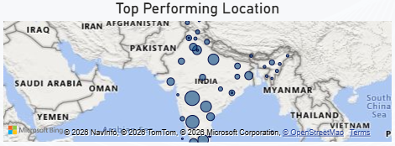
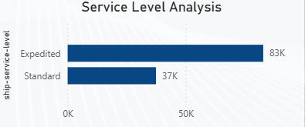
Top Performing Location
Service Level Analysis
Insight: Geographically visualizes market concentration, showing that the majority of the customer base is situated within the Indian subcontinent.
Insight: Shows that 'Expedited' shipping is the most utilized service level, reflecting customer preference for faster delivery times.

Slide 10
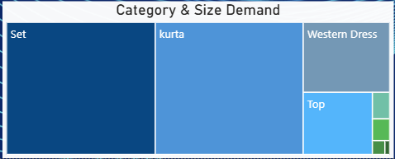
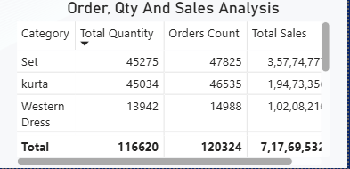
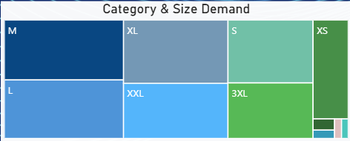
Category Demand
Order, Qty & Sales Analysis
Insight: Set' and 'Kurta' represent the highest inventory demand, with sizes M, L, and XL being the most popular across all categories, indicating a need for higher stock levels in these core segments.
Insight: Sets and Kurtas drive over 75% of total volume, with ‘Sets’ acting as the primary revenue engine, contributing 50% of total sales(Rs.3.57 Cr).

Slide 11

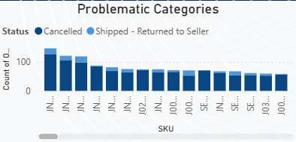
Cancellation Rate
Problematic Categories
Insight: Acts as a critical health metric, showing a 14% cancellation rate that needs to be monitored to improve overall customer satisfaction.
Insight: SKU JNE3797-KR-L is the most Problematic item with 128 cancellations. High returns are concentrated in specific western Dress SKUS rather than entire Categories

Slide 12
conclusion
Revenue Peak: Total sales of ₹71.77M was achieved, with a record peak of ₹26.27M in April 2022.
Top Sellers: 'Sets' and 'Kurtas' dominate the market, contributing over 75% of total orders.
Operational Loss: Business growth is hindered by a 14.22% cancellation rate, primarily affecting high-value transactions.
Customer Profile: Demand is strictly retail (99.3% B2C), with Maharashtra and Karnataka as the highest revenue clusters.
Logistics Gap: 69.78% of orders are Merchant-fulfilled, showing a clear need to scale Amazon FBA for faster delivery.

Slide 13
Recommendations
Implement High-Value Order Verification: With a cancellation rate of 14.2 %, the business should introduce an automated IVR or SMS verification for orders above ₹1,000. This will reduce "Return to Origin" (RTO) costs and improve the net realization of the ₹71.77M total sales.
Inventory Optimization for Top Regions: Geographical analysis shows Maharashtra, Karnataka, and Tamil Nadu as the highest revenue contributors. To ensure faster delivery and lower cancellations, the business should prioritize stock in regional fulfillment centers located in these specific clusters.

Slide 14
Scale Amazon FBA for Key Categories: Currently, 69.78% of orders are Merchant-fulfilled. Since the 'Expedited' service level is already high at 83K orders, transitioning top-selling categories like 'Set' and 'Kurta' to Amazon FBA will enhance customer trust and improve overall delivery performance.
Cross-Selling and Product Bundling: The dashboard shows that 'Set' is your highest revenue generator (₹36M), while ‘Kurta’ and 'Western Dress' are secondary.
Action: Launch "Complete the Look" bundles by pairing lower-selling categories (Tops/Western Dress) with high-performing 'Sets' at a discounted bundle price. This will help clear slower-moving inventory and increase the Average Order Value (currently ₹596.47).

Slide 15
Thank you
Email-Id – komalchahal2632@gmail.com
Linkedin Id - https://www.linkedin.com/in/komal-chahal-242024244/
Github Id https:/github.com/komalchahal

